Slide 1
Biomolecules: Proteins and Nucleic acids
BIO 101
Adu, Oluwatosin B.
C19-

Slide 2
PROTEIN
A protein is a large organic molecule constructed of a chain of amino acids. The word protein, derived from the Greek proteios, loosely means “holding first place”
They orchestrate the business of life by controlling multiple bioprocesses including metabolism, cell growth, and neurotransmission.
Proteins also provide structure and can act as energy source, the main reason they are so important is their role as enzymes—enabling chemical reactions that are critical to life.
Proteins are polymers of amino acids, with each amino acid residue joined to its neighbor by a specific type of covalent bond called peptide bond.
Twenty different amino acids are commonly found in proteins.

Slide 3
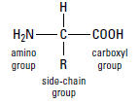
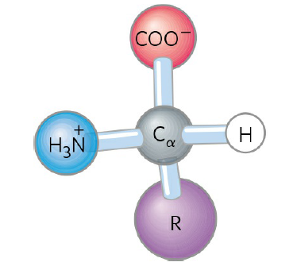
Amino Acids
All 20 of the common amino acids are α-amino acids.
They have a carboxyl group and an amino group bonded to the same carbon atom (the α carbon).
They differ from each other in their side chains, or R groups, which vary in structure, size, and electric charge, and which influence the solubility of the amino acids in water.
In addition to these 20 amino acids there are many less common ones.
The common amino acids of proteins have been assigned three letter abbreviations and one-letter symbols, which are used as shorthand to indicate the composition and sequence of amino acids polymerized in proteins.
General structure of an amino acid

Slide 4
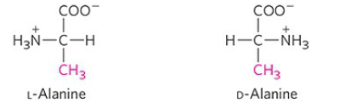
For all the common amino acids except glycine, the α carbon is bonded to four different groups: a carboxyl group, an amino group, an R group, and a hydrogen atom (in glycine, the R group is another hydrogen atom).
The α-carbon atom is thus a chiral center. With two possible stereoisomers- D and L.
The amino acid residues in protein molecules are exclusively L stereoisomers.
D-Amino acid residues have been found in only a few, generally small peptides, including some peptides of bacterial cell walls and certain peptide antibiotics.
The two stereoisomers of alanine, L- and D-alanine,

Slide 5
Amino acids in solution at neutral pH exist mainly as zwitterions rather than as unionized molecules.
Zwitterions have both a positive and a negative charge.
The amino group carries a positive charge (NH₃⁺) and the carboxyl group carries a negative charge (CO₂⁻).
The presence of both charges means that the molecule can act as both an acid and a base, that is, amphoteric.

Slide 6
Classification of amino acids
Amino acids can be classified on the following bases:
Nature of the R- group: Amino acids can be grouped into five main classes based on the properties of their R groups, particularly their polarity, or tendency to interact with water at biological pH. These are
Nonpolar, aliphatic R groups e.g., Gly, Ala, Val
Aromatic R groups e.g., Phe, Tyr, Trp
Polar, uncharged R groups e.g., Ser, Thr, Cys
Positively charged R groups (Acidic) e.g., Lys, His , Arg,
Negatively charged R groups (Basic) eg., Asp and Glu

Slide 7
2. Fate of the carbon skeleton: Amino acids can be classified into two groups based on the metabolic fate of their carbon skeleton. These are
Glucogenic e.g., Phe, Tyr, Ile
Ketogenic e.g., Leu, Lys
Some amino acids are both glucogenic and ketogenic e.g., Trp, Phe and Tyr
3. Nutritional need: Based on the ability of mammals to synthesise them, amino can be classified as
Essential amino acids cannot be synthesized in the body and so must be obtained from food e.g., His, Ile
Nonessential amino acids can be synthesized by the body e.g., Pro, Ser
10 amino acids are essential for children but only 8 are essential for adults

Slide 8
Assignment
List all the 20 amino acids with their three letter and 1 letter notations and classify them based on all the 3 criteria stated above.

Slide 9
Proteins
Two amino acid molecules can be covalently joined through a substituted amide linkage, termed a peptide bond, to yield a dipeptide.
Three amino acids can be joined by two peptide bonds to form a tripeptide; similarly, four amino acids can be linked to form a tetrapeptide, five to form a pentapeptide, and so forth.
When a few amino acids are joined in this fashion, the structure is called an oligopeptide.
When many amino acids are joined, the product is called a polypeptide. Proteins may have thousands of amino acid residues.
Molecules referred to as polypeptides generally have molecular weights below 10,000, and those called proteins have higher molecular weights.
In a peptide, the amino acid residue at the end with a free α-amino group is the amino-terminal (or N-terminal) residue; the residue at the other end, which has a free carboxyl group, is the carboxyl-terminal (C-terminal) residue.

Slide 10
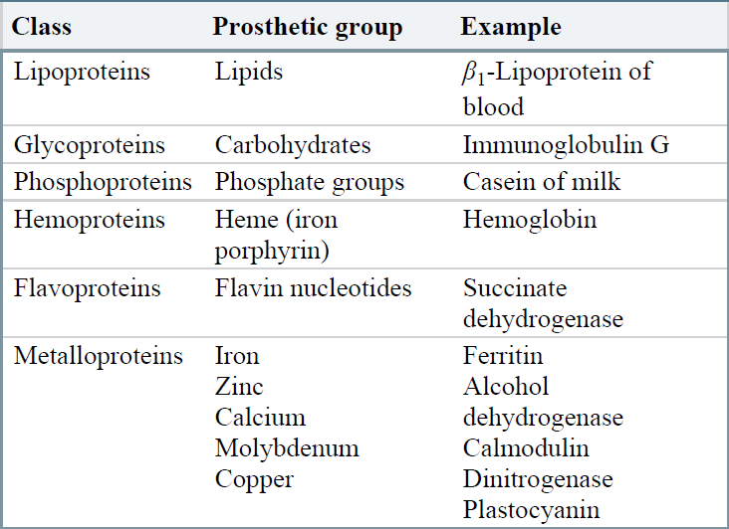
Conjugated proteins
Many proteins, e.g., chymotrypsin, contain only amino acid residues and no other chemical constituents; these are simple proteins.
Some proteins contain associated chemical components in addition to amino acids; these are conjugated proteins.
The non–amino acid part of a conjugated protein is its prosthetic group.
Conjugated proteins are classified on the basis of the chemical nature of their prosthetic groups e.g. glycoproteins = protein + sugar
prosthetic group plays an important role in the protein’s biological function.
Conjugated Proteins

Slide 11
Structural organization of proteins
The spatial arrangement of atoms in a protein or any part of a protein is called its conformation or shape. This conformation is essential for the function of proteins.
The shape of a protein develops in stages. Protein structures generally are described at four levels: primary, secondary, tertiary, and quaternary.
Primary structure is simply the two-dimensional linear sequence of amino acids in the peptide chain. The primary structure is a long string of amino acids forming polypeptide chains stabilised by covalent bond
Secondary structure is formed as the protein twists in accordance with chemical forces within the primary chain. The hydrogen in the amine groups and the oxygen in the carboxyl groups of the backbone form hydrogen bonds that stabilize the secondary structures.

Slide 12
Secondary structure commonly takes one of two forms.
left-handed helix that is developed as the molecule twines around itself. This form is called an α-helix. Globular proteins typically contain the α-helix form. Hormones are globular proteins.
The other secondary form is a crimped shape called a β-pleated sheet. A β-pleated sheet looks a little like a piece of tin. β-Sheets are usually found in structural proteins, such as silk and the β-keratin proteins found in claws, beaks, and shells of turtles.

Slide 13
Tertiary structure is the final 3-Dimensional shape of one folded amino acid chain.
The final shape of any polypeptide chain is unique and will have specific areas that are necessary for the function of the protein.
The tertiary structure is stabilized by hydrogen bond, ionic bond, hydrophobic interactions and disulfide bonds
A quaternary structure may be formed from the association of two or more peptide strands.
Some proteins are large and complex, consisting of many polypeptide chains. These proteins have quarternary structure.
Hemoglobin (with four polypeptide chains) and (with three chains) are proteins with quarternary structure.
The formation of disulfide bonds is important in the quaternary structure of many proteins.

Slide 14
Functions of Proteins
Some of the important functions of proteins include:
✓ Proteins are enzymes. Enzymes make chemical reactions happen faster.
✓ Proteins reinforce structures. Proteins are part of the structure of plasma membranes, and cytoskeletal proteins. Proteins in the extracellular matrix support cells e.g. collagen.
✓ Proteins transport materials into and out of the cell. Proteins in the plasma membrane help molecules enter and exit the cell.
✓ Proteins are involved in cellular identity. Glycoproteins on cell surfaces act as a marker that identifies the cell type.

Slide 15
✓ Proteins help cells move. Cytoskeletal proteins power the movement of flagella and allow cells to crawl.
✓ Proteins help cells communicate. Proteins are receptors for signals. Also, some signaling molecules, like insulin, are proteins.
✓ Proteins organize molecules within the cell. Chaperone proteins assist folding of new proteins and guide proteins to their proper locations within the cell.

Slide 16
NUCLEIC ACIDS
Nucleotides are one of the most important classes of molecules in the body.
They act as the basis for sources of energy (adenosine triphosphate [ATP], guanosine triphosphate [GTP]) that drive biochemical reactions.
Important constituent in several coenzymes,
The most famous role of the nucleotides is as a component of the nucleic acids- RNA and DNA.
A nucleotide has three characteristic components:
(1) a nitrogenous base,
(2) a pentose, and
(3) one or more phosphates
The molecule without a phosphate group is called a nucleoside.
The nitrogenous bases are derivatives of two parent compounds, pyrimidine and purine. The bases and pentoses of the common nucleotides are heterocyclic compounds.

Slide 18
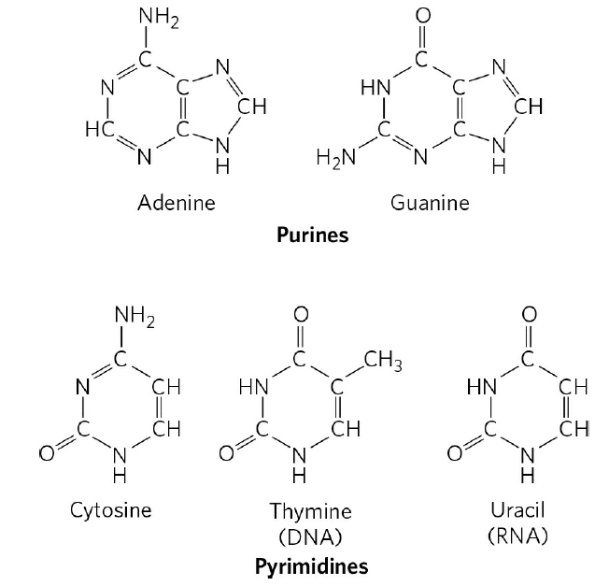
Both DNA and RNA contain two major purine bases, adenine (A) and guanine (G), and two major pyrimidines.
In both DNA and RNA one of the pyrimidines is cytosine (C), but the second common pyrimidine is not the same in both: it is thymine (T) in DNA and uracil (U) in RNA.
Major purine and pyrimidine bases of nucleic acids.

Slide 19
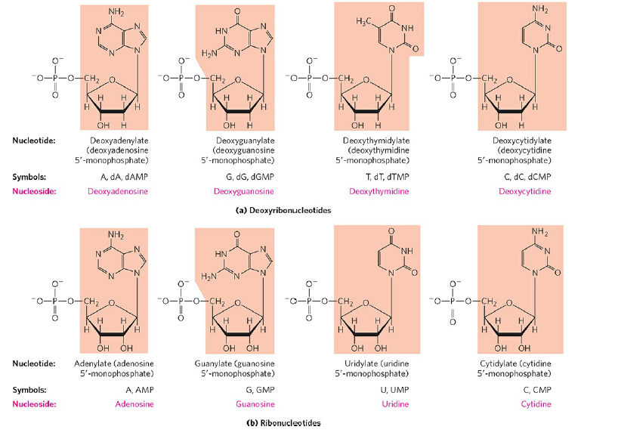
Nucleic acids have two kinds of pentoses: deoxyribonucleotide units of DNA contain 2′-deoxy-D-ribose, and the ribonucleotide units of RNA contain D-ribose. In nucleotides, both f pentoses are in their β-furanose form.

Slide 20
Nucleic Acids
Successive nucleotides of DNA and RNA are covalently linked through phosphodiester bond in which the 5′-phosphate group of one nucleotide unit is joined to the 3′-hydroxyl group of the next.
The covalent backbones of nucleic acids consist of alternating phosphate and pentose residues, and the nitrogenous bases may be regarded as side groups joined to the backbone at regular intervals.
Polymers containing 50 or fewer nucleotides are generally called oligonucleotides.
A longer nucleic acid is called a polynucleotide.

Slide 21
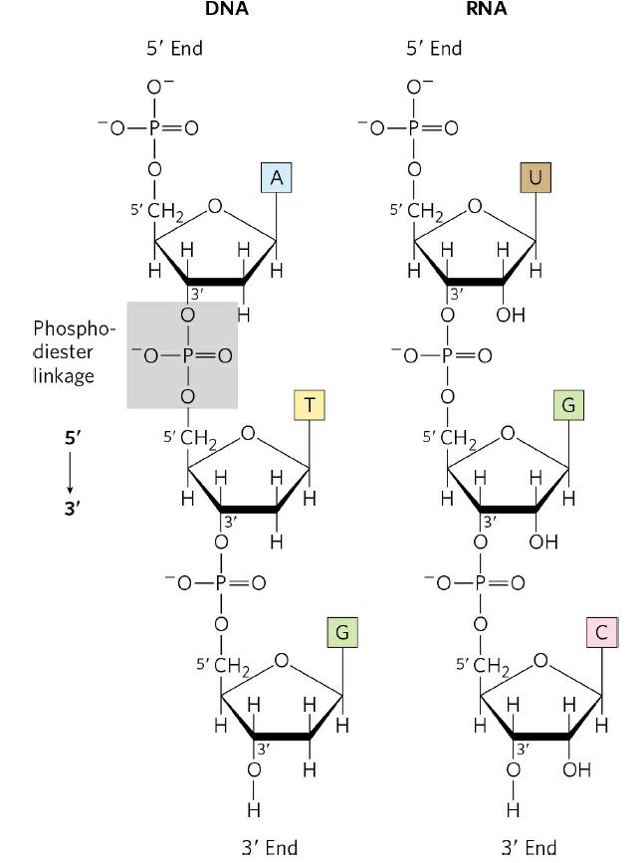
Phosphodiester linkages in the covalent backbone of DNA and RNA.

Slide 22
The order and type of nucleotides in a polynucleotide strand make up its primary structure.
The order of nitrogenous bases within a polynucleotide chain is called its sequence.
Both DNA and RNA are made of polynucleotide chains, but the two types of molecules are unique.
Three major differences exist between DNA and RNA:
✓DNA contains the nitrogenous base thymine, while RNA contains uracil. (Both contain adenine, guanine, and cytosine.)
✓DNA nucleotides have the sugar deoxyribose, while RNA nucleotides have ribose.
✓DNA molecules are double-stranded, while RNA molecules are single stranded.

Slide 23
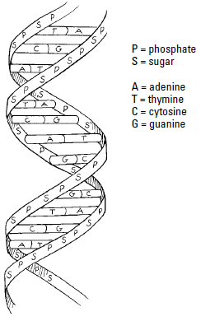
The double helix of DNA
Polynucleotide chains interact with each other and with themselves to give nucleic acids three-dimensional shape, called their secondary structure.
The secondary structure of DNA is a double helix.
Two polynucleotide chains join together, forming a molecule with the shape of a twisted ladder. The sides of the ladder are made of the sugar phosphate backbones of the two strands.
The nitrogenous bases project off of the sugar-phosphate backbone and join together by hydrogen bonds, forming the “rungs” of the ladder.
The double helix structure of DNA.

Slide 24
The two chains of the double helix are antiparallel to each other, i.e. they are opposite in polarity.
The two antiparallel strands of DNA are held together by hydrogen bonds between their nitrogenous bases.
In order for the hydrogen bonds to form, Adenine (A) forms hydrogen bonds with thymine (T), and cytosine (C) forms hydrogen bonds with guanine (G).
In DNA, A is complementary to T, and C is complementary to G.
When these bases match up, they form complementary base pairs. The base pairing rules for DNA are A=T and C=G.

Slide 25
The Function of DNA and RNA
DNA and RNA molecules are involved in information storage and retrieval in cells.
DNA stores the information that ultimately determines the characteristics of cells and organisms. The information is written in a chemical code determined by the order of nitrogenous bases within the DNA.
When cells decode the DNA message, it provides instructions for important cell structures and functions, including the following:
✓ Protein structure is determined by the sequence of nucleotides in DNA. Through the processes of transcription and translation, the code in DNA is copied and used to specify the sequence of amino acids (primary structure) in polypeptide chains.
✓ RNA structure is also determined by the sequence of nucleotides in DNA. Through the process of transcription, the sequence of nucleotides in DNA is used to build RNA molecules.

Slide 26
Types of RNA
Several types of RNA molecules are built from the information in DNA. Each type of RNA has a different function in cells:
✓Messenger RNA (mRNA) carries the code for protein structure from the DNA to ribosomes where it can be used to produce proteins.
✓Transfer RNA (tRNA) decodes the message in mRNA by matching amino acids to the mRNA code.
✓Ribosomal RNA (rRNA) is part of the structure of the ribosome.

